Slide 1
Aakash Goel https://www.linkedin.com/in/goelaakash123/
Session 3:
Low Level Vision
Acknowledgement: Slide Materials adopted from - Intro to Computer Vision (Cornell Tech); Noah Snavely, prepared by the lead instructor Prof S P Vimal , modified (added some content) by Aakash Goel

Slide 2
Topics
Image Histogram & Histogram Equalization
Basic Intensity Transformations
Image Smoothing
Color Images; Color spaces: RGB and HSV
Acknowledgement: Slide Materials adopted from - Intro to Computer Vision (Cornell Tech); Noah Snavely

Slide 3
Image Histogram : What ?
An image histogram is a graph showing the distribution of pixel intensities in an image.
X-axis → intensity values (0 to 255 for 8-bit grayscale)
Y-axis → number of pixels having that intensity

Slide 4
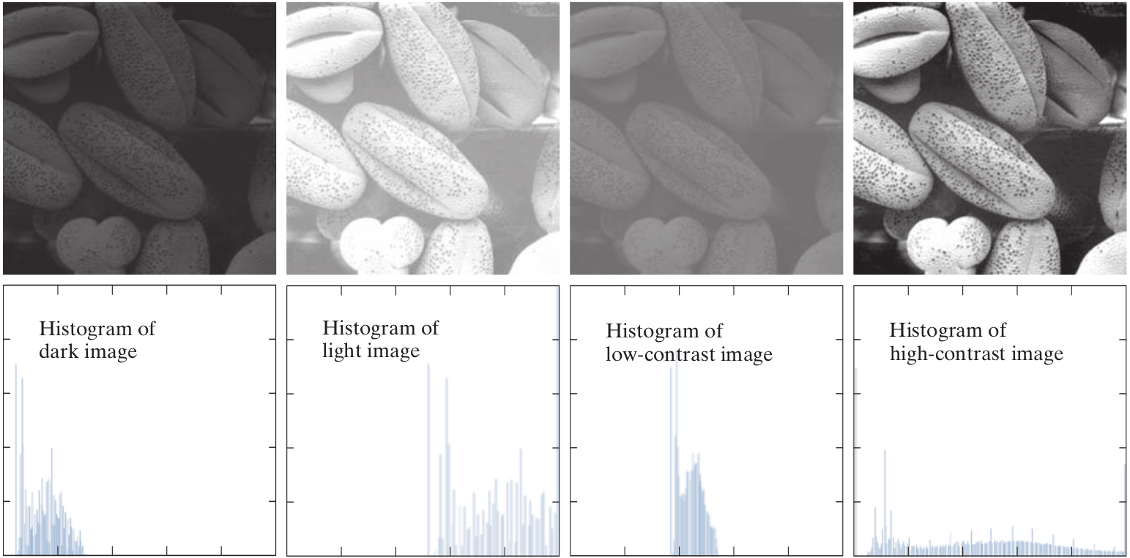
Image Histogram
Histogram shape is related to image appearance ;

Slide 5
Image Histogram : Why Important ?
It helps us:
Understand brightness/contrast of the image.
Detect whether the image is too dark (left-skewed), too bright (right-skewed), or low-contrast (narrow range).
Decide if enhancement (e.g., equalization) is needed.
📷 Real-world Analogy
Think of an image like a room of people and histogram as a bar chart of their heights.
If everyone is of similar height (flat histogram), it lacks contrast—like an image with dull tones.
If people range from short to tall (spread histogram), it's rich in variety—like a high-contrast image.

Slide 6
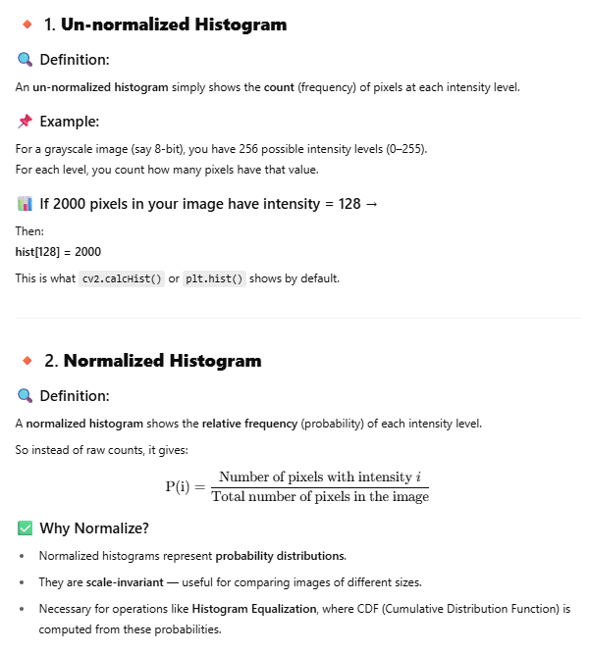
Image Histogram : Normalized Vs. Un-Normalized
Intensity | Count (Un-normalized) | P(i) (Normalized)
0 | 4 | 4 / 16 = 0.25
100 | 6 | 6 / 16 = 0.375
200 | 6 | 6 / 16 = 0.375
Type | What it shows | Use Case
Un-normalized | Absolute pixel counts | Basic visualization
Normalized | Probability of intensity | Contrast analysis, Histogram Equalization, ML input features

Slide 7
Histogram Equalization: What ?
It is a technique to redistribute pixel intensities to improve the contrast of an image.
In many real-world cases:
Images are too dark (e.g., taken at night).
Images are low-contrast due to fog, poor lighting, etc.
Equalization makes features more visible by spreading out the histogram.
⚙️ Real-world Analogy
Imagine redistributing wealth in a country:
Before equalization: few rich, many poor (intensity concentrated).
After equalization: more balanced wealth (intensity spread).

Slide 8
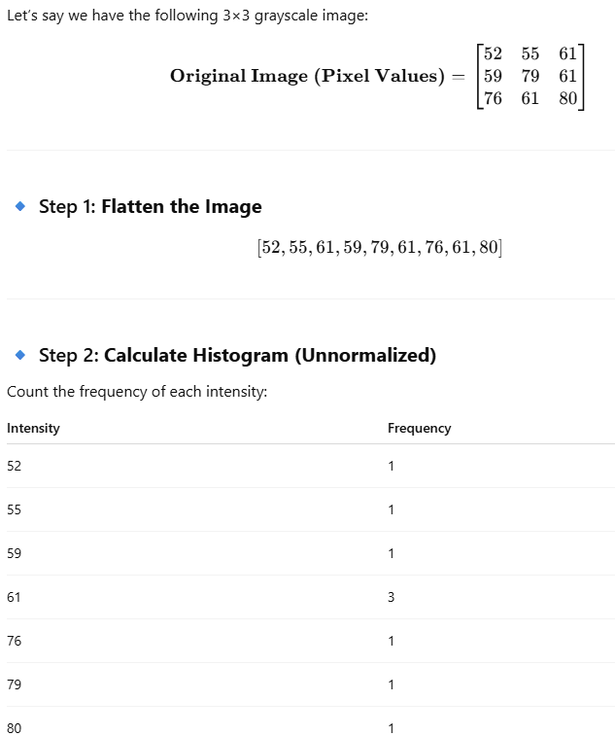
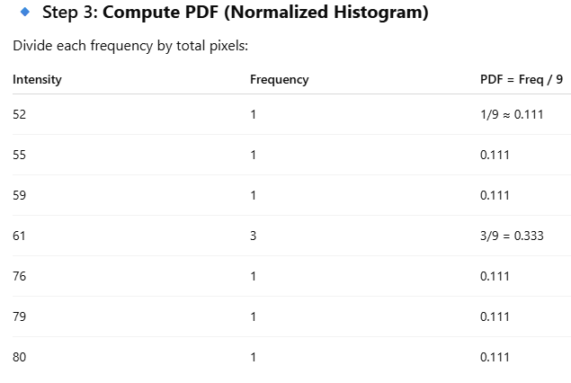
Histogram Equalization: How ?
CDF (Cumulative Distribution Function) of histogram is computed.
CDF is normalized and used to map old intensity values to new ones.
This mapping makes dark areas brighter and bright areas darker—resulting in contrast enhancement.

Slide 9
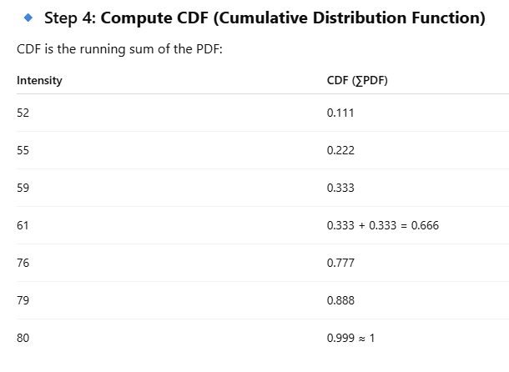
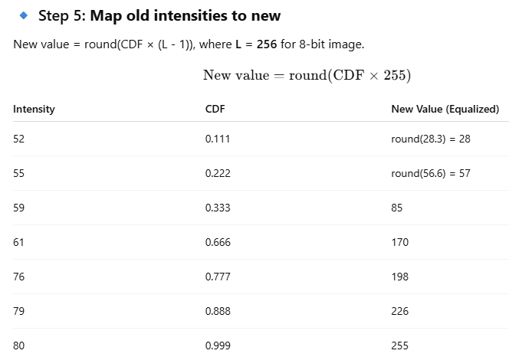
Histogram Equalization : How ?

Slide 10
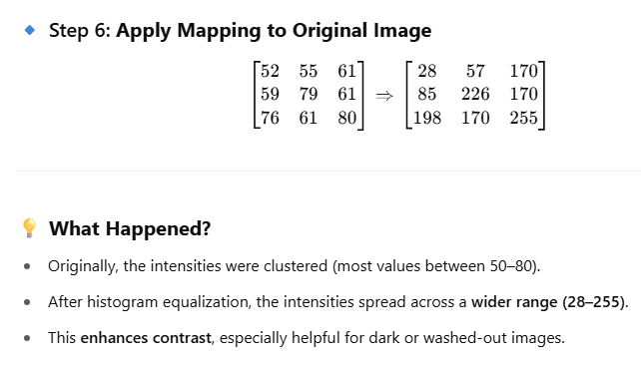
Histogram Equalization: How ?

Slide 11
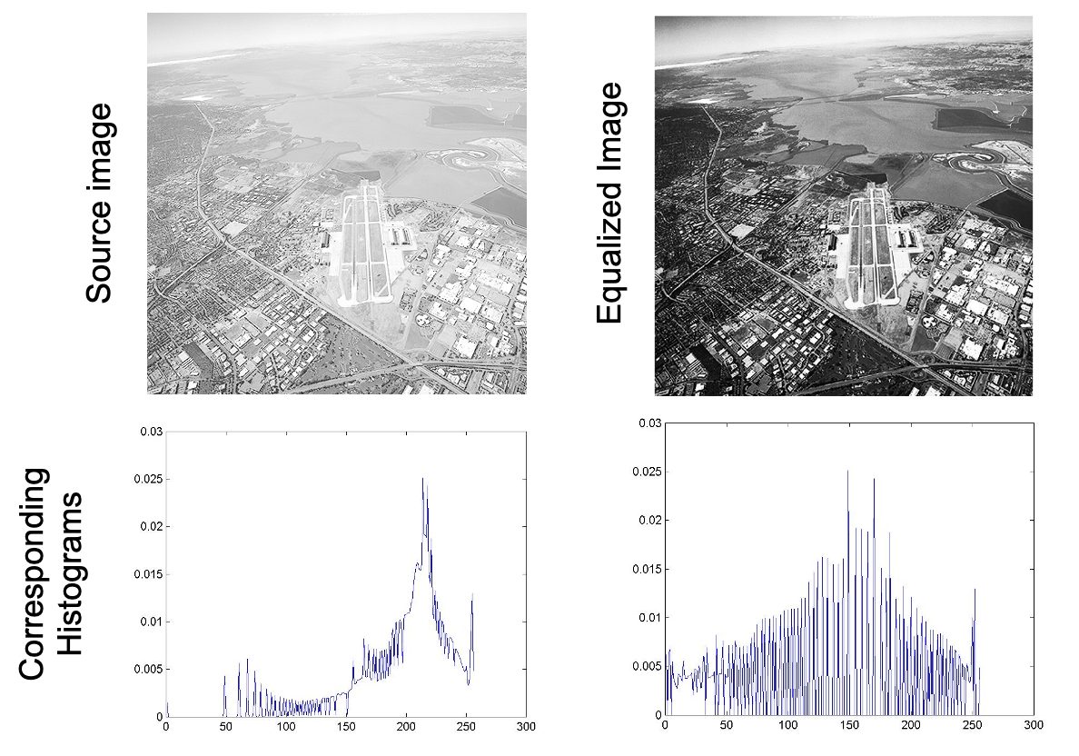
Histogram Equalization

Slide 12
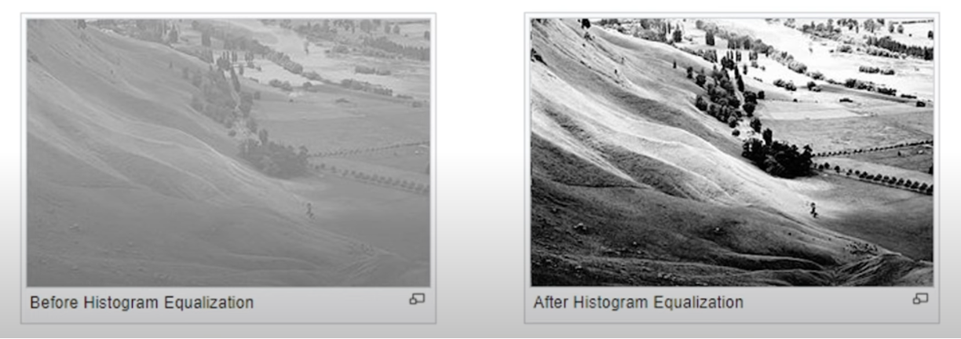
Histogram Equalization
Often images poorly use the full range of the gray scale
Solution:
Transform image such that its histogram is spread out more evenly in grayscale

Slide 13
Elementary Intensity Transformations in Image Processing
These are basic pixel-wise operations applied to each pixel’s intensity in an image. They're like mathematical functions that map input intensity values to output intensity values.
🔹 Why do we need them?
Enhance contrast
Brighten or darken an image
Suppress background
Highlight features
Prepare for segmentation or feature extraction

Slide 14
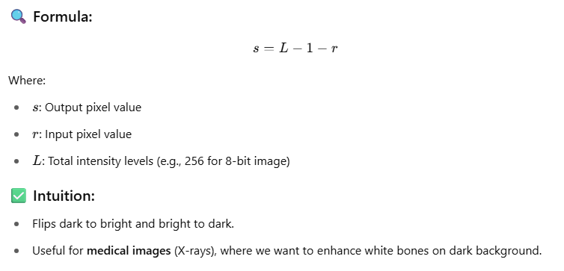
Image Negatives

Slide 15
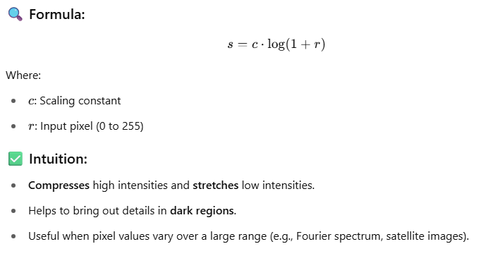
Log Transformations

Slide 16
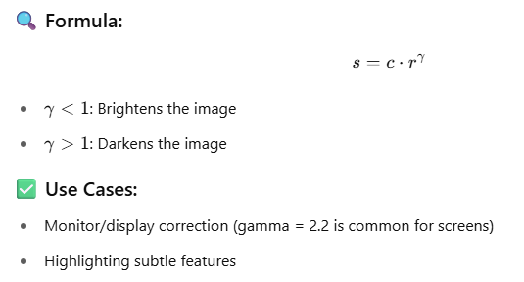
Power-Law (Gamma) Transformation

Slide 17
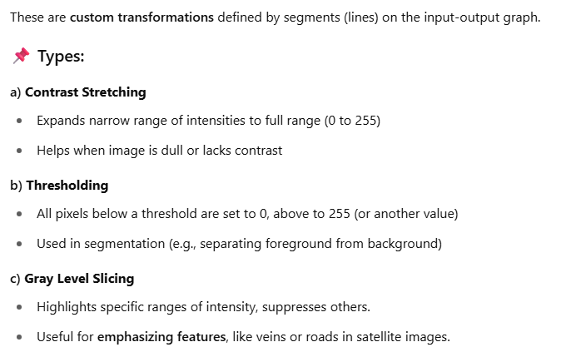
Piecewise Linear Transformations

Slide 18
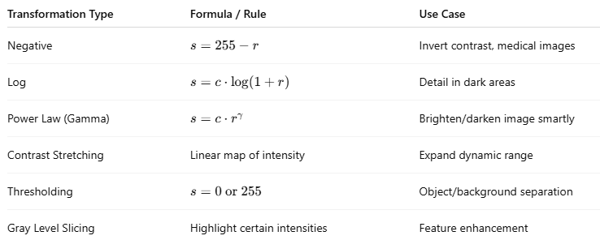
Image Transformation: Summary
💡 Real-World Example:
Let’s say you have a CCTV night image:
It’s dark → use log transformation to reveal hidden details.
After that, apply contrast stretching for better visual impact.

Slide 19
Image Smoothing: What ?
Image Smoothing refers to the technique of reducing noise and detail in an image by averaging pixel values with their neighbors. It's a form of low-pass filtering.

Slide 20
Image Smoothing: Why ?
Real-World Intuition:
Imagine a photo taken in low light—it often looks grainy (has noise).
Or a fingerprint image that needs to be pre-processed before feature extraction.
Before edge detection, segmentation, or object detection, we often apply smoothing to reduce irrelevant details.

Slide 21
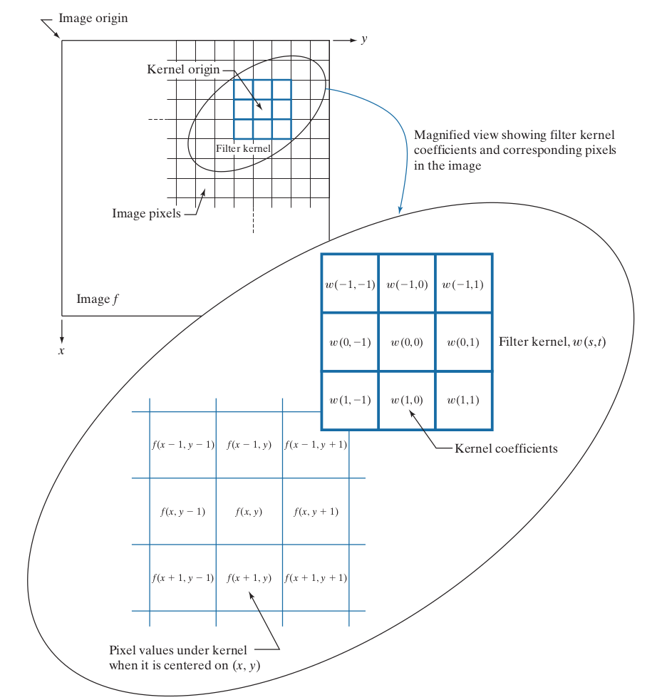
Spatial Filtering
CV 3: Digital Image Fundamentals - Low Level Vision
Note:
Origin of the image is at the top left, but the origin of the kernel is at its center.
Placing the origin at the center of spatially symmetric kernels simpliﬁes writing expressions for linear ﬁltering.
Convolution
Correlation

Slide 22
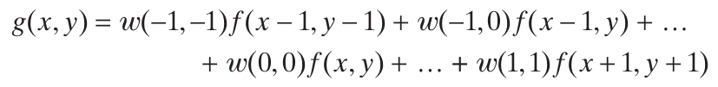
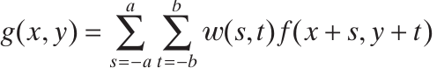
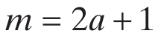
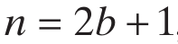
Spatial Filtering
CV 3: Digital Image Fundamentals - Low Level Vision
Note:

Slide 23
Spatial Filtering
A spatial filter consists of (a) a neighborhood, and (b) a predefined operation
Linear spatial filtering of an image of size MxN with a filter of size mxn is given by the expression

Slide 24
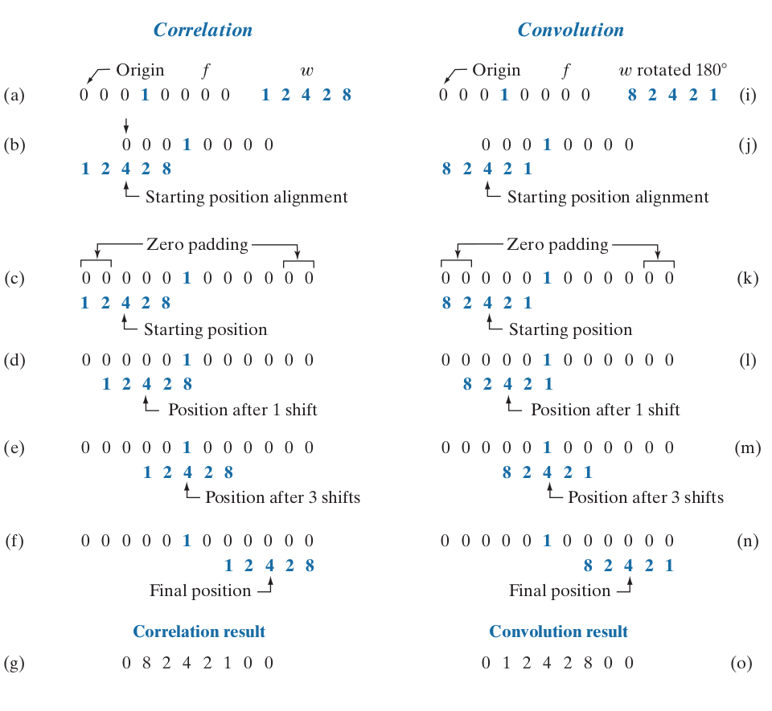
Spatial Filtering

Slide 25
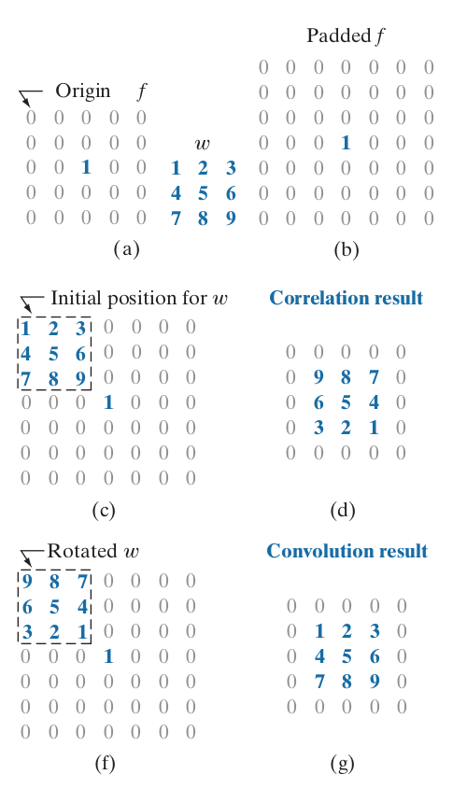
Spatial Filtering

Slide 26
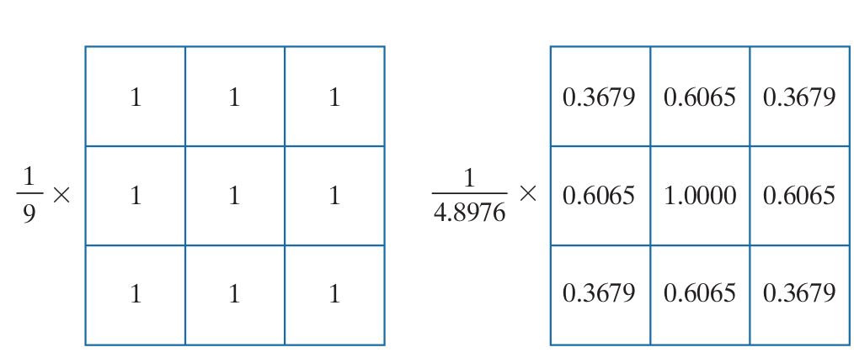
Smoothing Spatial Filters
Box kernel Gaussian kernel.

Slide 27
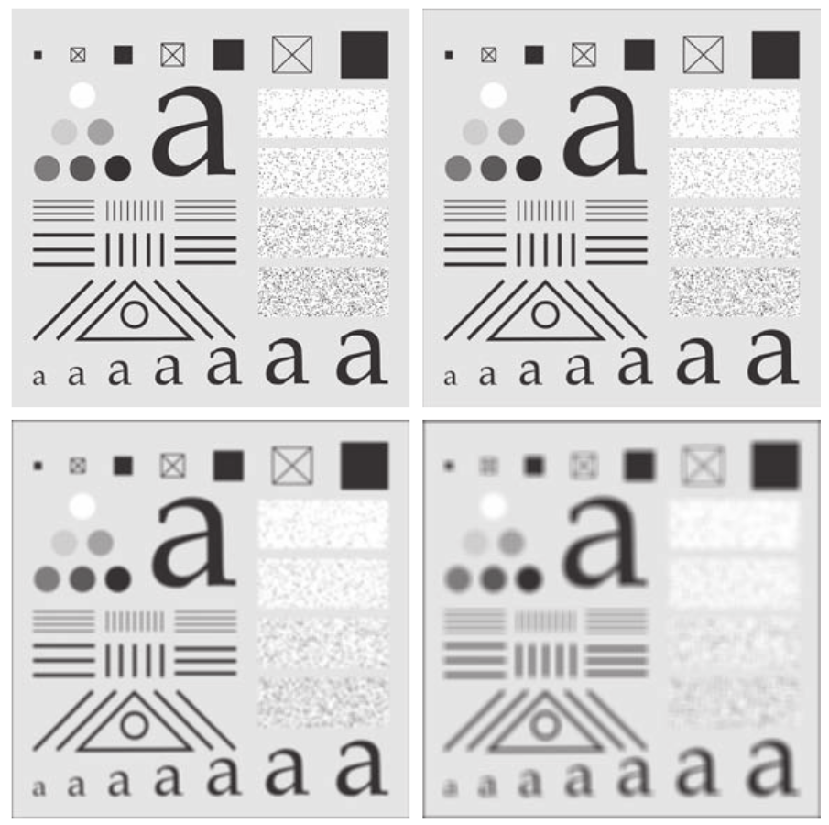
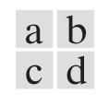
Smoothing Spatial Filters
(a) Test pattern of size 1024 × 1024 pixels.
(b)-(d) Results of low pass ﬁltering
with box kernels of sizes 3 × 3,
11 × 11, and 21 × 21, respectively.

Slide 28
Smoothing Spatial Filters
(a) Test pattern of size 1024 × 1024 pixels.
(b)-(d) Results of low pass ﬁltering
with box kernels of sizes 3 × 3,
11 × 11, and 21 × 21, respectively.

Slide 29
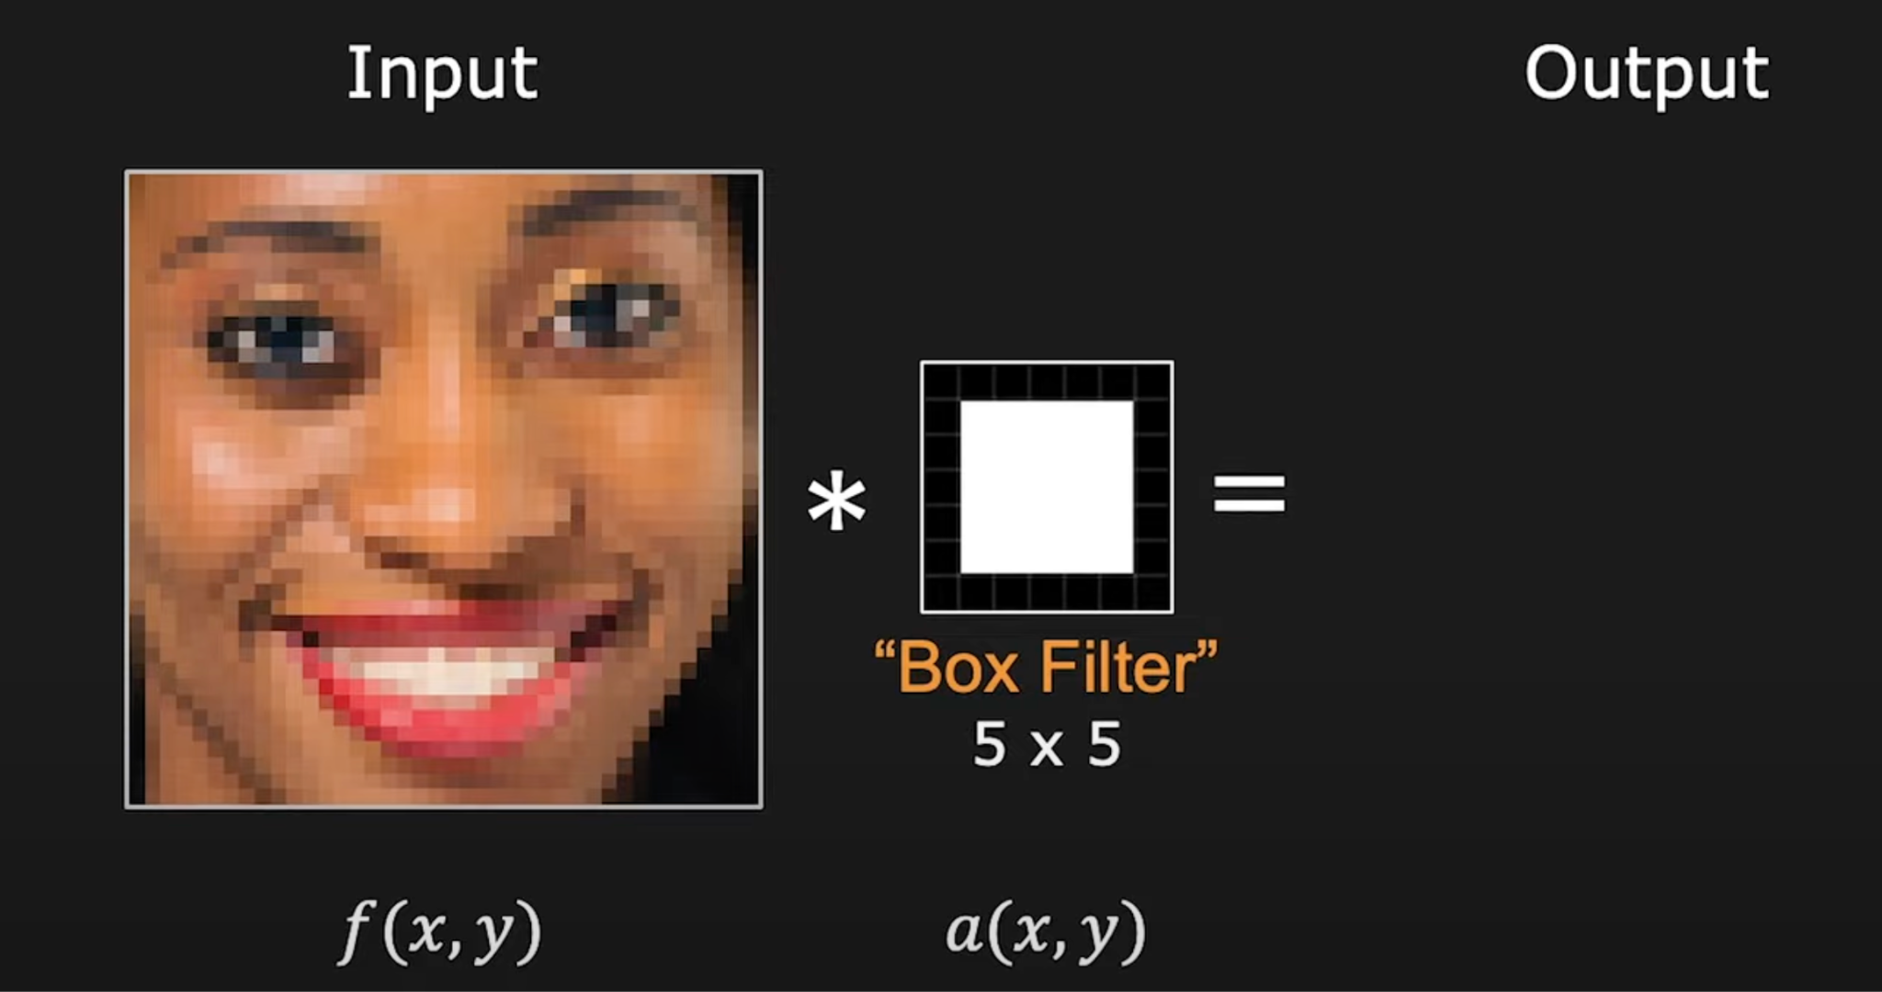
Box Filter
Credits:First Principles of Computer Vision lecture series by Shree Nayar

Slide 30
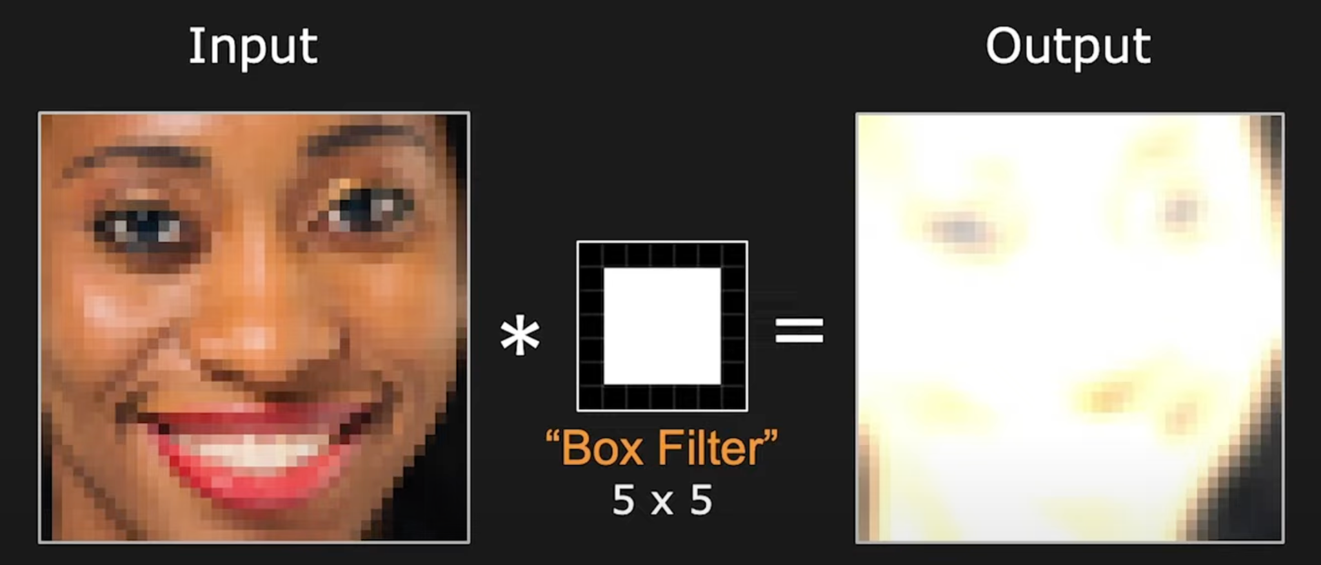
Box Filter
Credits:First Principles of Computer Vision lecture series by Shree Nayar

Slide 31
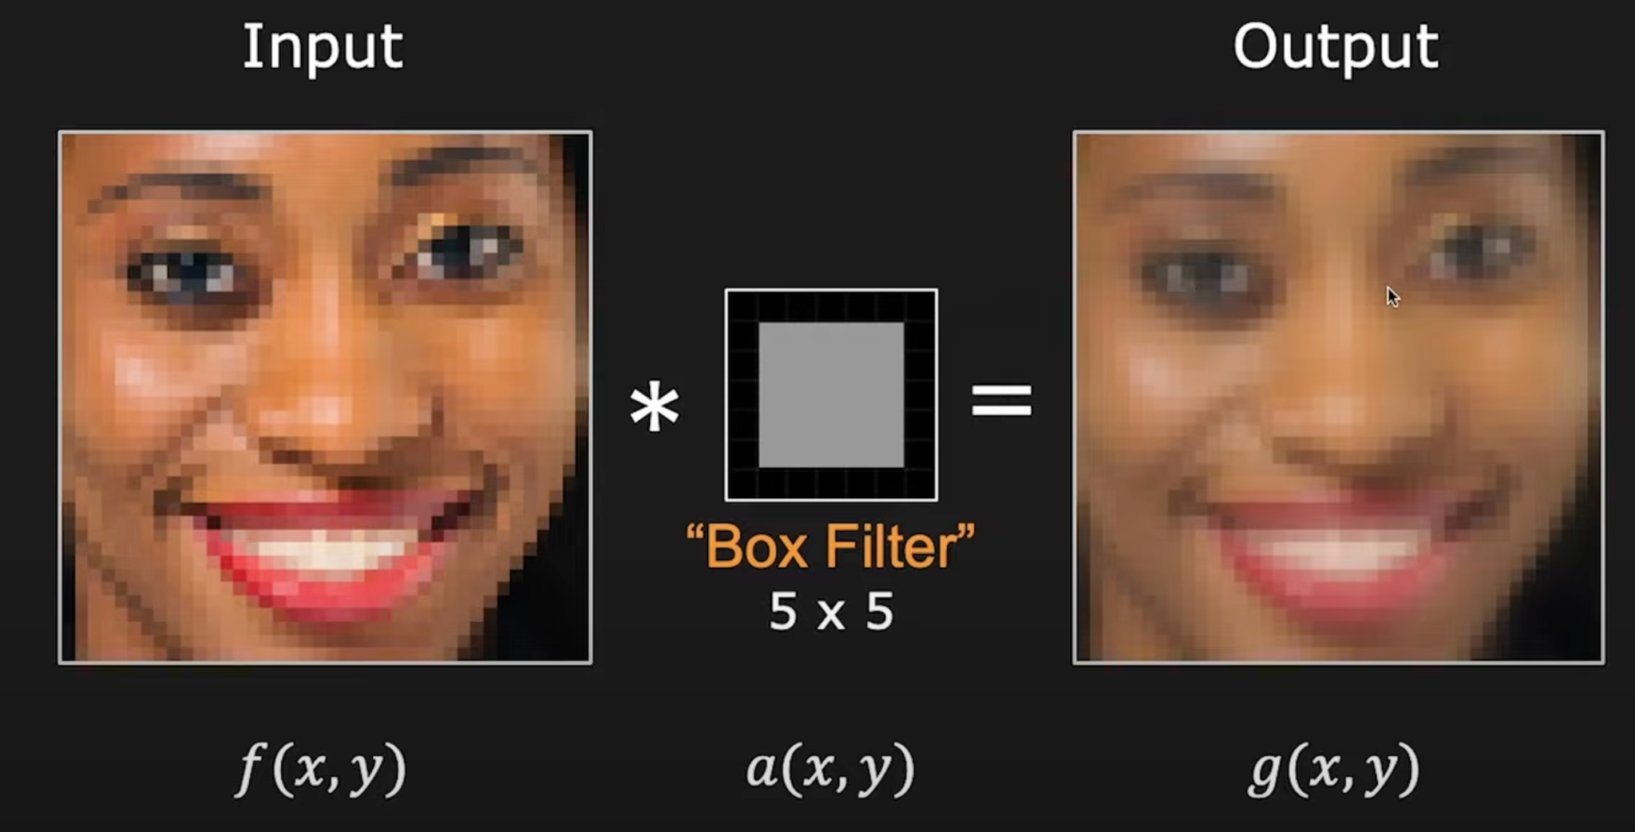
Box Filter
Credits:First Principles of Computer Vision lecture series by Shree Nayar

Slide 32
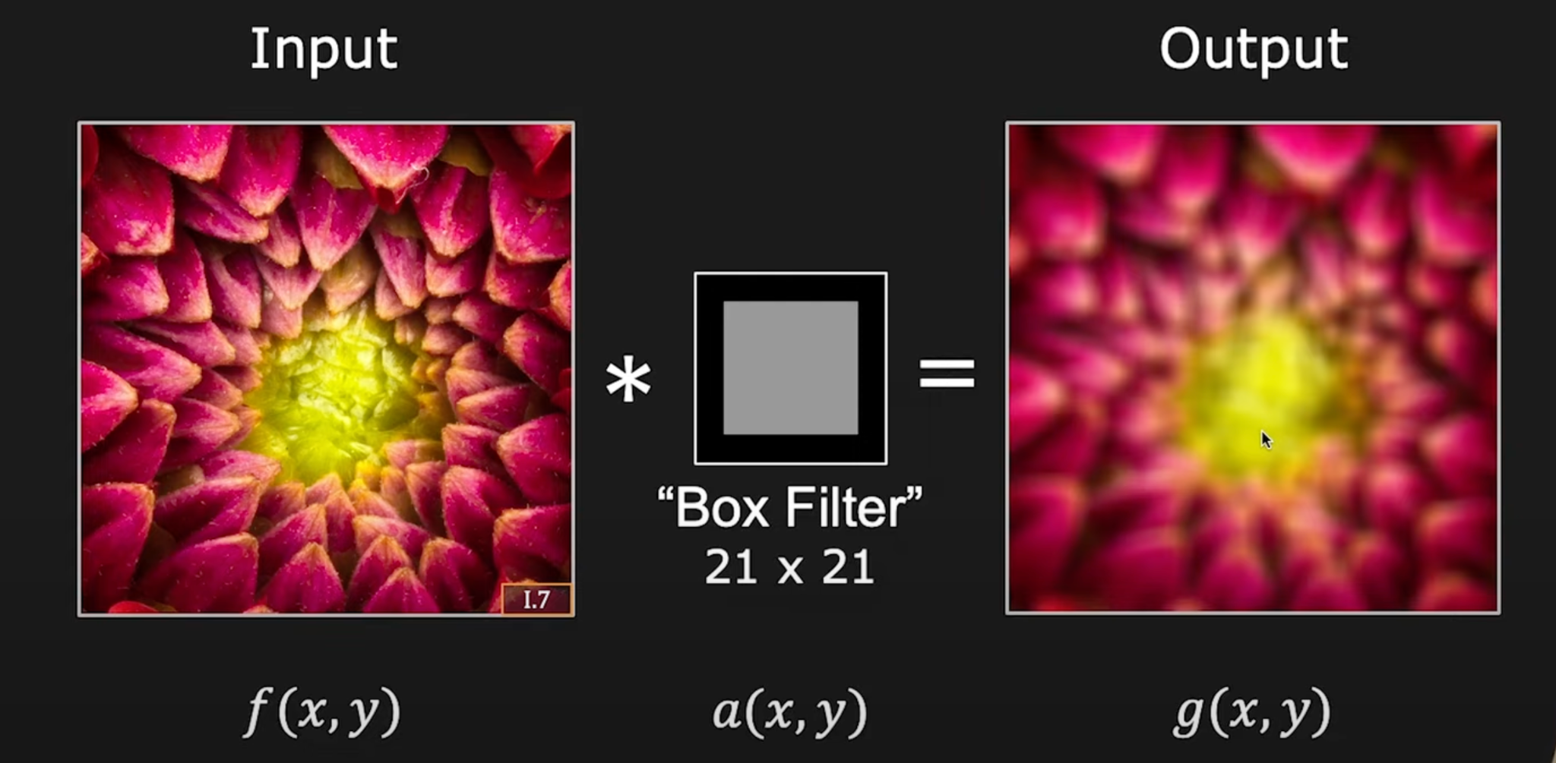
Smoothing with box filter
Credits:First Principles of Computer Vision lecture series by Shree Nayar

Slide 33
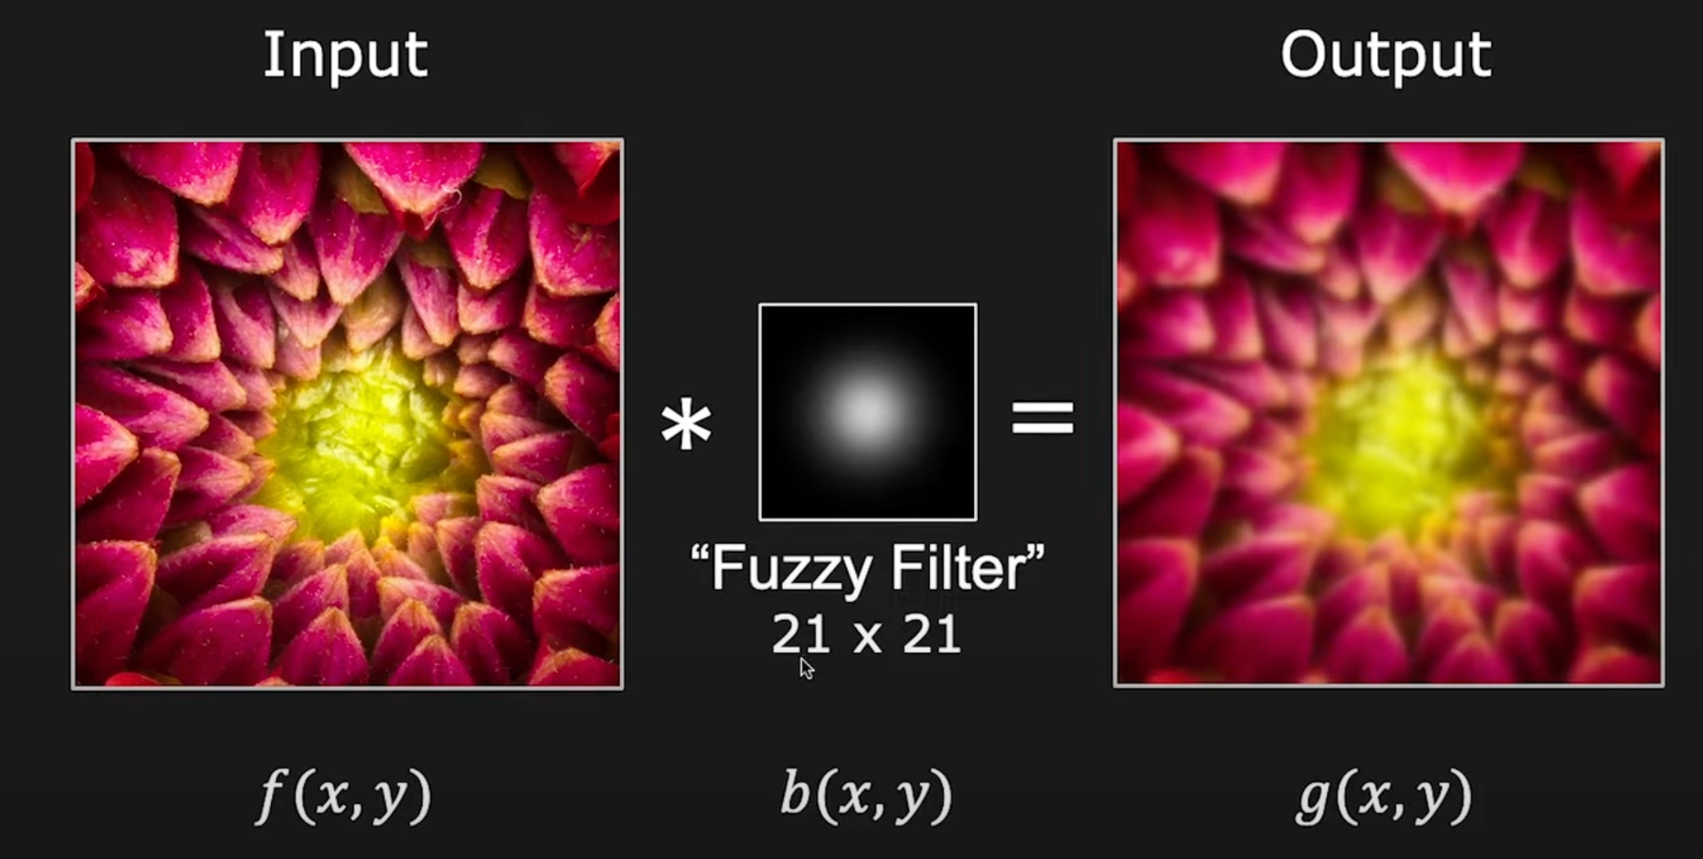
Fuzzy filter
Credits:First Principles of Computer Vision lecture series by Shree Nayar

Slide 34
Spatial Filtering
A spatial filter consists of (a) a neighborhood, and (b) a predefined operation
Linear spatial filtering of an image of size MxN with a filter of size mxn is given by the expression

Slide 35
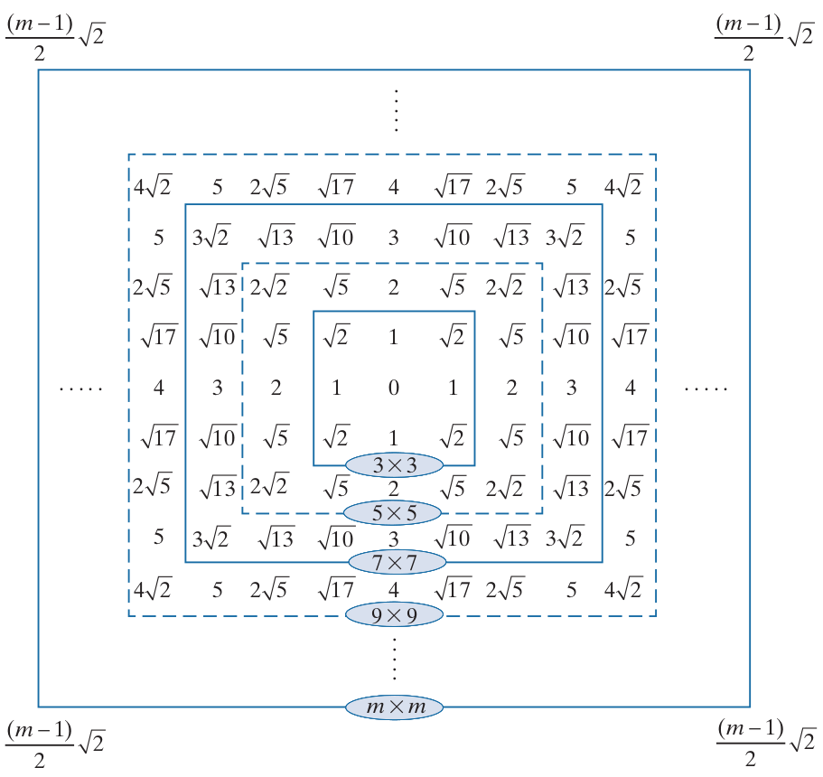
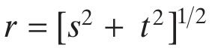
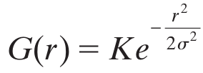
Gaussian Filters
Let s and r be position of a cell in a filter w.r.t the origin; r represent the distance of the cell from the center
Form of Gaussian kernels is as below:
Distances from the center for various sizes of square kernels.

Slide 36
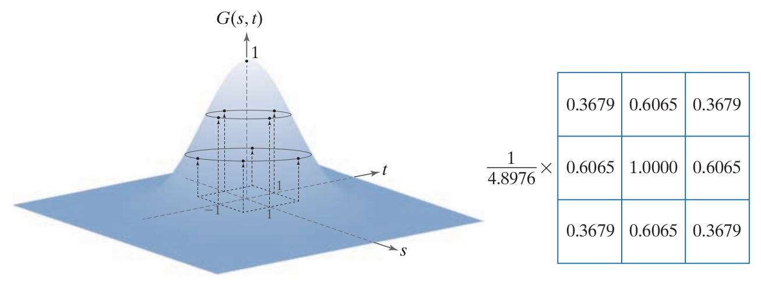
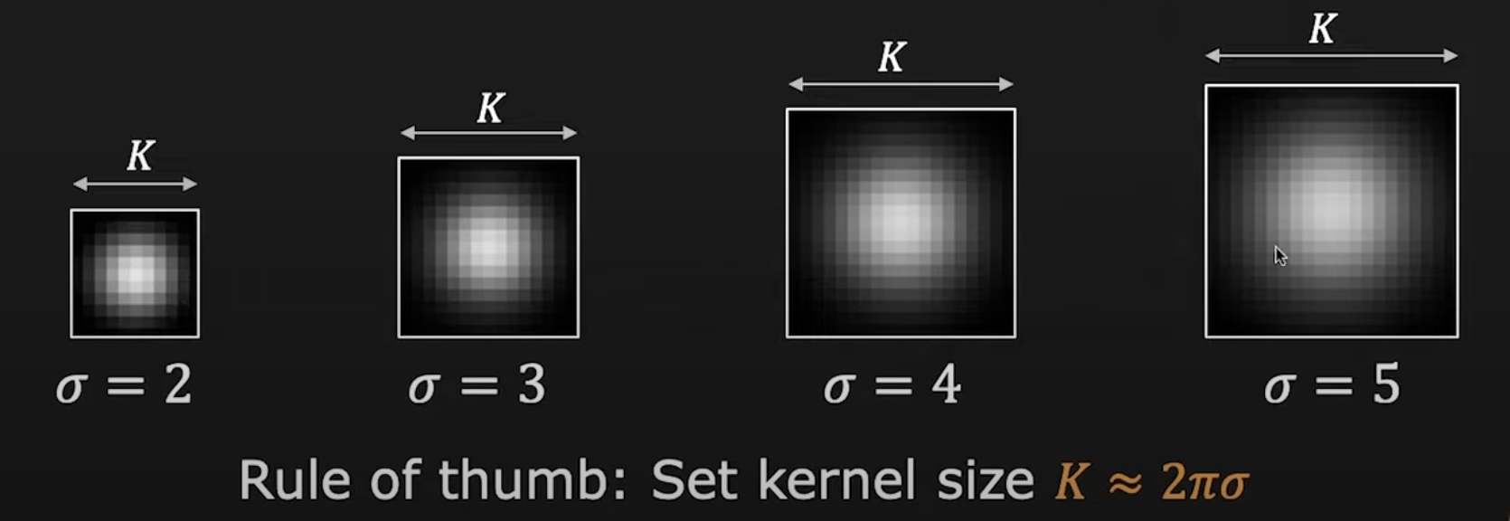
Gaussian Filters
Sampling a Gaussian function to obtain a discrete Gaussian kernel. The values shown are for K = 1 and 𝛔 = 1.
Resulting 3 × 3 kernel

Slide 37
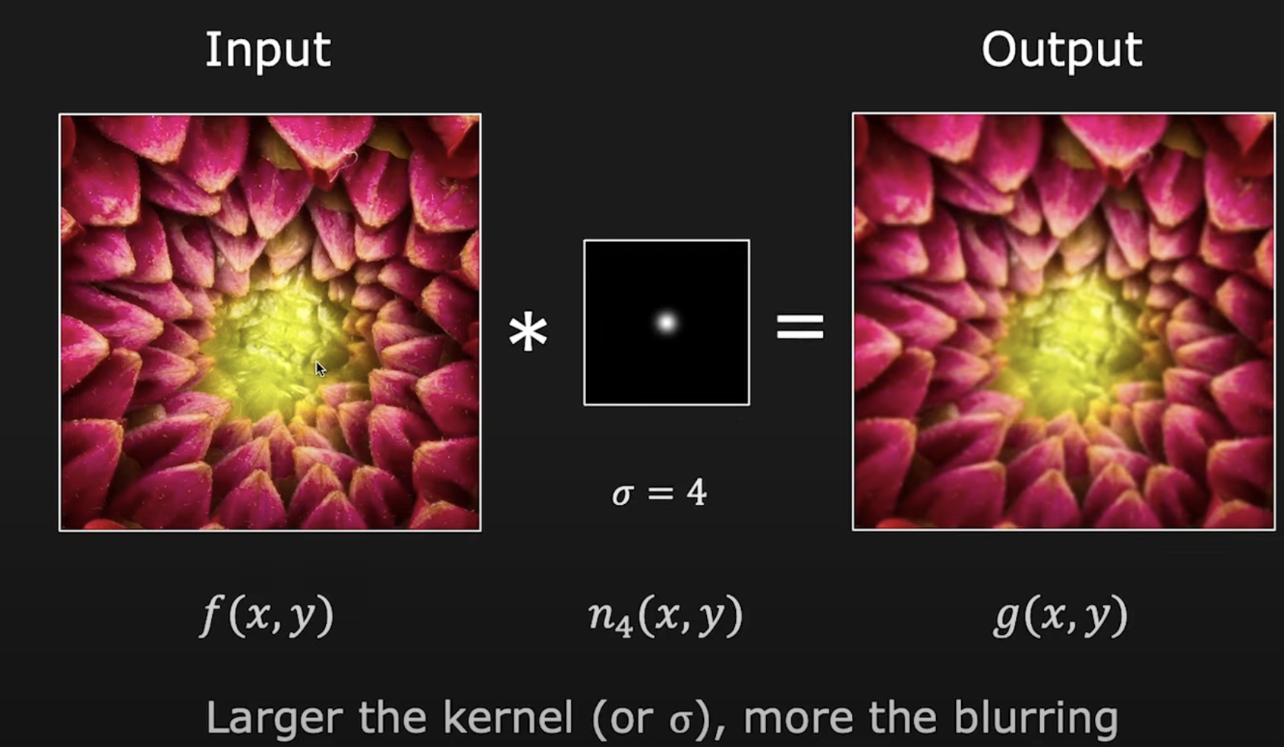
Gaussian smoothing

Slide 38

Gaussian Filters
A test pattern of size 1024 × 1024
lowpass ﬁltering the pattern with a Gaussian kernel of size 21 × 21, with 𝛔= 3.5, K=1
Result of using a kernel of size 43 × 43, with 𝛔 = 7, K=1

Slide 39

Gaussian Filters
Gaussian kernels of size 43 × 43, with 𝛔 = 7
Kernel of 85 × 85, with 𝛔 = 7
Difference image

Slide 40
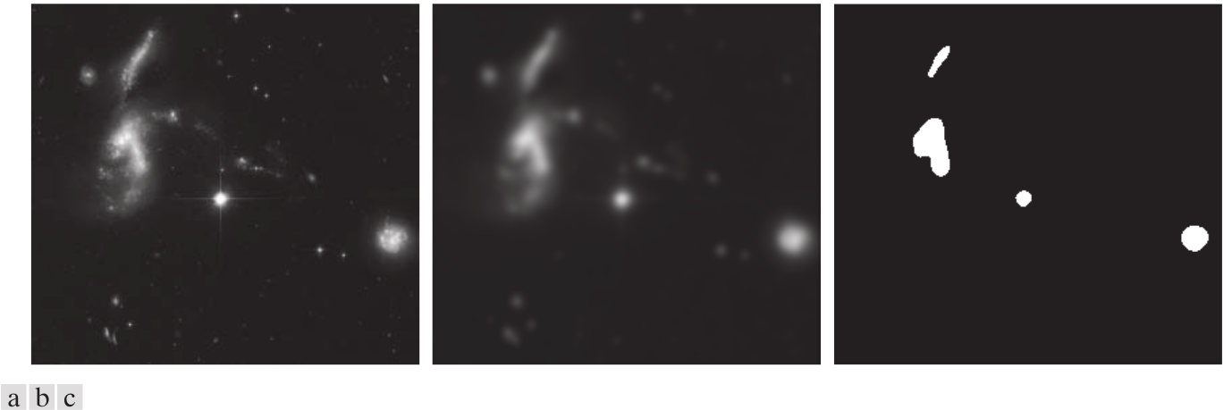
Gaussian Filters - Example Usage
A 2566 × 2758 Hubble Telescope image of the Hickson Compact Group
Result of lowpass ﬁltering with a Gaussian kernel.
Result of thresholding the ﬁltered image (intensities were scaled to the range [0, 1])

Slide 41
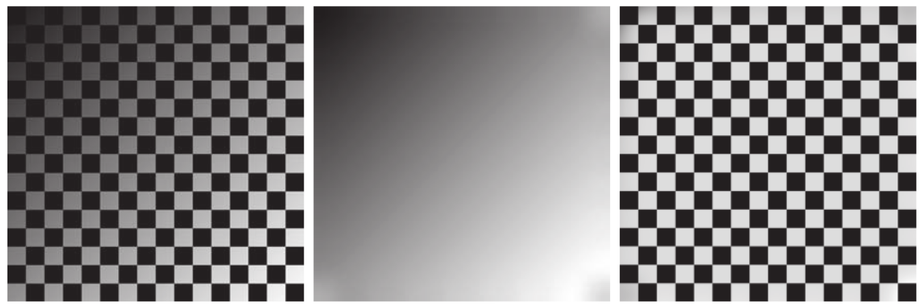
Gaussian Filters - Example Usage
Image shaded by a shading pattern oriented in the −45° directio
Estimate of the shading patterns obtained using lowpass ﬁltering.
Result of dividing (a) by (b). (See Section 9.8 for a morphological approach to shading correction).

Slide 42
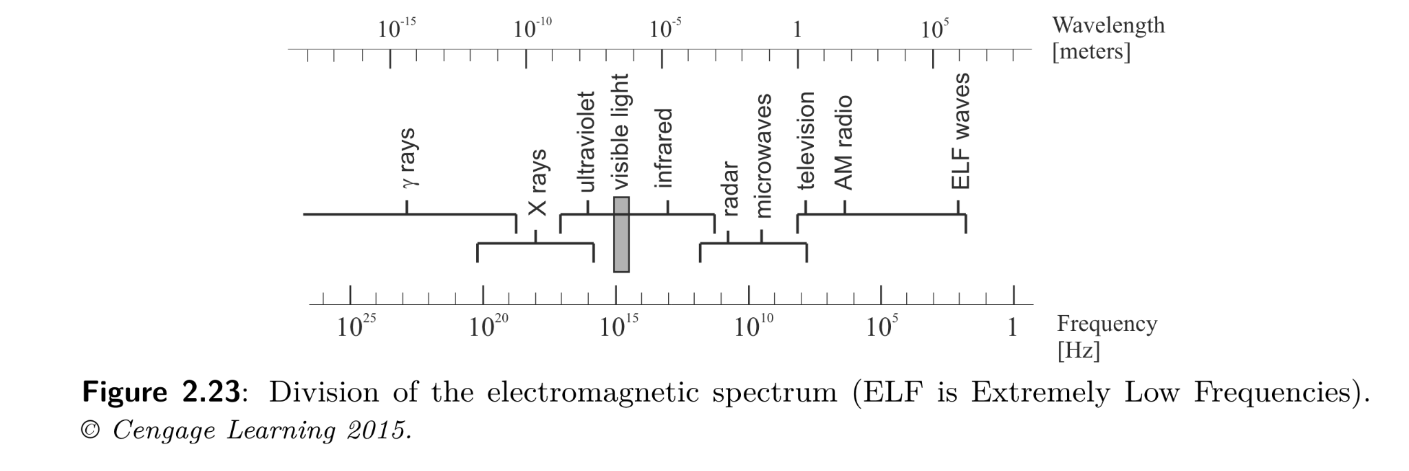
Color Images
Light is an electromagnetic wave

Slide 43
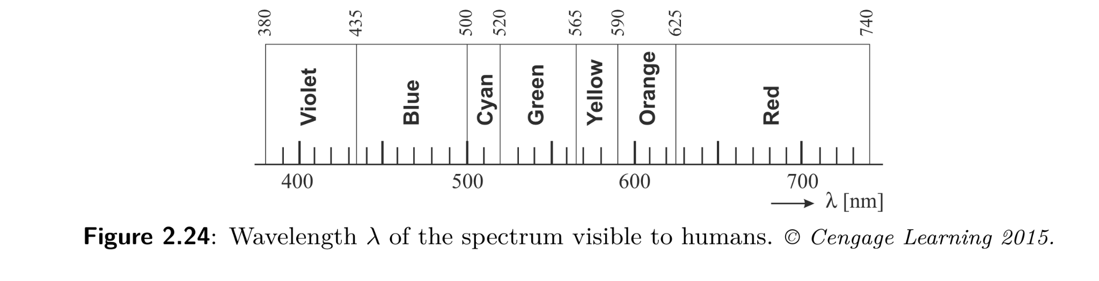
Wavelength spectrum visible to humans
If its wavelength is comprised between 400 and 700 nm (visible spectrum), the wave can be detected by the human eye and is called monochromatic light
Visible colors with the wavelengths shown in Figure 2.24 are called spectral colors

Slide 44
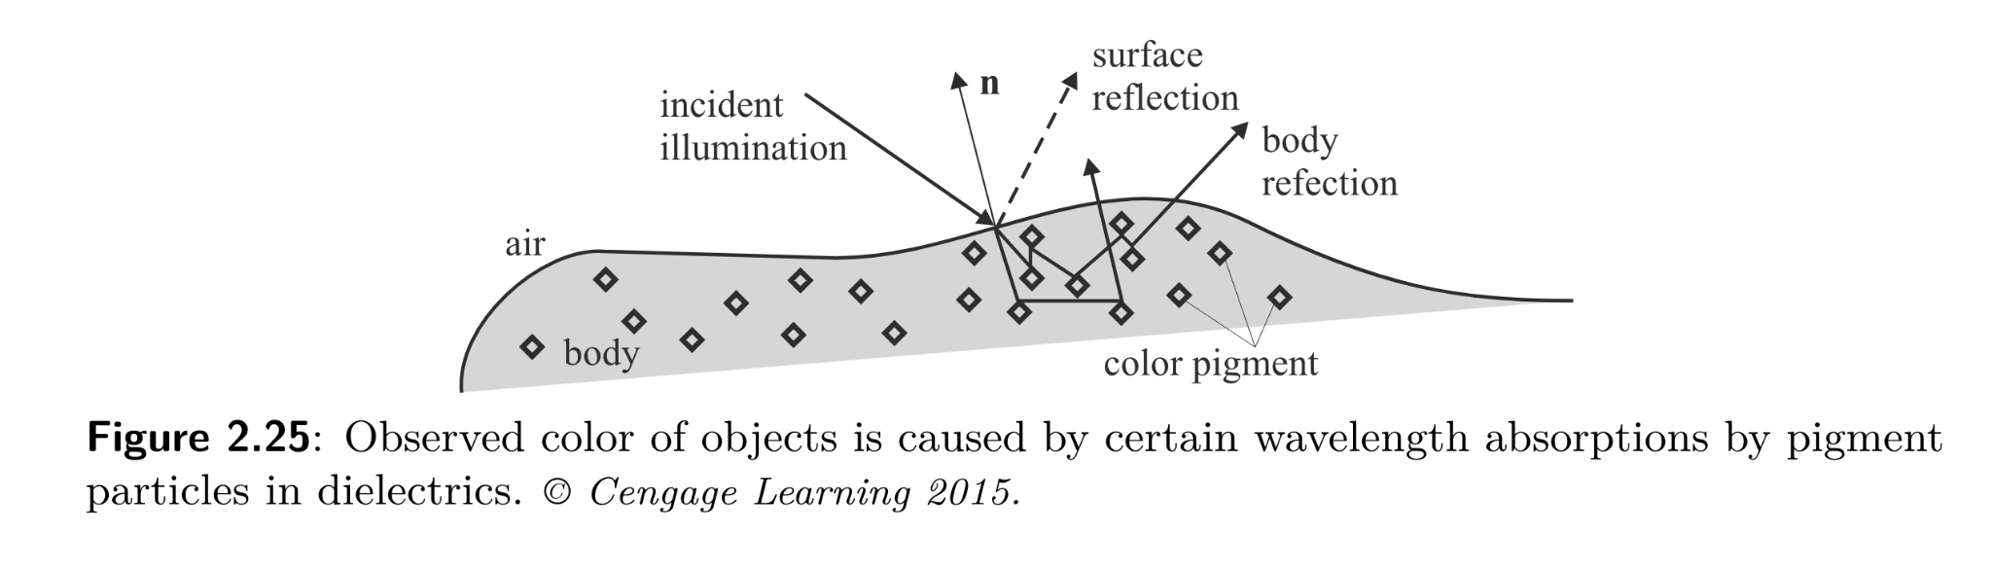
Observation of Color
Light is fundamental for color vision
Unless there is a source of light, there is nothing to see!
What do we see?
We do not see objects, but the light that has been reflected by or transmitted through the objects

Slide 45
What is color?
It is an attribute of objects (like texture, shape, smoothness, etc.)
It depends on:
1) spectral characteristics of the light source(s) (e.g., sunlight) illuminating the objects (relative spectral power distribution(s) SPD)
2) spectral properties of objects (reflectance)
3) spectral characteristics of the sensors of the imaging device (e.g., the human eye or a digital camera)

Slide 46
Primary and Secondary Colors
Due to the different absorption curves of the cones, colors are seen as variable combinations of the so-called primary colors: red, green, and blue
Their wavelengths were standardized by the CIE (International Commission on Illumination) in 1931: red=700 nm, green=546.1 nm, and blue=435.8 nm
The primary colors can be added to produce the secondary colors of light, magenta (R+B), cyan (G+B), and yellow (R+G)

Slide 47
Colors in computer graphics and vision
• How to specify a color?
– set of coordinates in a color space
• Several Color spaces
• Relation to the task/perception
– blue for cold water

Slide 48
Color Models
The purpose of a color model
(or color space or color system) is to facilitate the specification of colors in some standard way
A color model provides a coordinate system and a subspace in it where each color is represented by a single point
Interactive platform: https://chromatone.center/theory/color/models/

Slide 49
Color spaces
• Device based color spaces:
– color spaces based on the internal of the device:
RGB, CMYK, YCbCr
• Perception based color spaces:
– color spaces made for interaction: HSV
• Conversion between them?

Slide 50
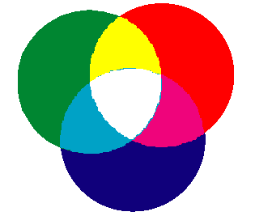
Red-Green-Blue
• Most commonly known color space
– used (internally) in every monitor
– additive

Slide 51
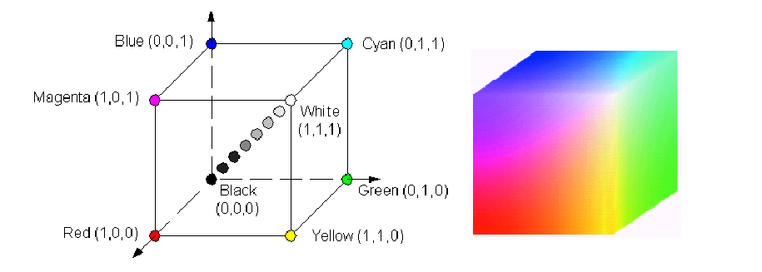
Red-Green-Blue The RGB Color Model
If R,G, and B are represented with 8 bits (24-bit RGB
image), the total number of colors is (2^8 )^3=16,777,216

Slide 52
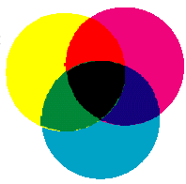
Cyan-Magenta-Yellow
• Used internally in color printers
• Subtractive
• Complementary to RGB:
•C=1-R
•M=1-G
•Y=1-B
• Also CMYK (blacK)
– mostly for printer use

Slide 53
CMYK
• K is for blacK
• Save on color inks, by using black ink preferably
• K = min(C,M,Y)
• C = C-K
• M = M-K
• Y = Y-K

Slide 54
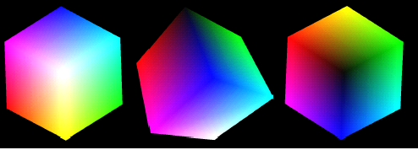
The RGB color cube
https://chromatone.center/theory/color/models/

Slide 55
The HSI Color Model
RGB, CMY, and the like are hardware-oriented color spaces
(suited for image acquisition and display)
The HSI (Hue, Saturation, Intensity) is a perceptive color space
(suited for image description and interpretation)
It allows the decoupling of chromatic signals (H+S) from the intensity signal (I)

Slide 56
Brightness, Hue, and Saturation
Brightness is a synonym of intensity
Hue represents the impression related to the
dominant wavelength of the color stimulus
Saturation expresses the relative color
purity (amount of white light in the color)
Hue and Saturation taken together are called
the chromaticity coordinates (polar system)
Matlab conversion function: rgb2hsv

Slide 57
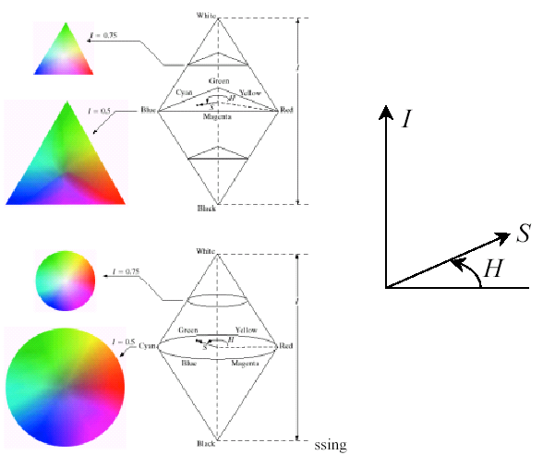
Two HSI Color Models

Slide 58
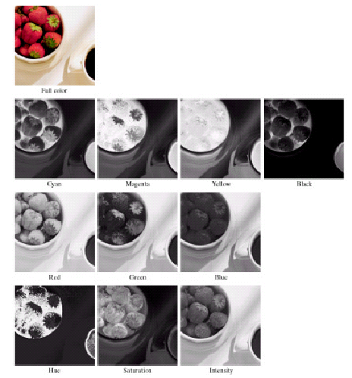
Example Comparison: CMYK, RGB, and HSI

Slide 59
Class Y color spaces – similar to HSI
• YIQ, YUV, YCbCr…
• Used in television sets and videos
– Y is luminance
– I and Q is chromaticity
• BW television sets display only Y
• Color TV sets convert to RGB
• YUV=PAL, YIQ=NTSC

Slide 60
Interests of Class Y
• Sometimes you have to use it
– video input/output
• Makes sense in image compression:
– better compression ratio if changing class Y
before compression
– High bandwidth for Y
– Small bandwidth for chromaticity
– Lab is fine for that too

Slide 61
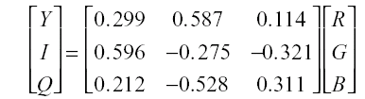
YCbCr Color Space is used in MPEG video compression standards
• Y is luminance
• Cb is blue chromaticity
• Cr is red chromaticity
Y = 0.257*R + 0.504*G + 0.098*B + 16
Cr = 0.439*R − 0.368*G − 0.071*B + 128
Cb = − 0.148*R − 0.291*G + 0.439*B + 128
• YIQ color space (Matlab conversion function: rgb2ntsc):

Slide 62
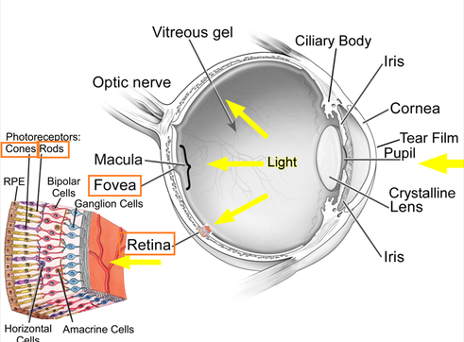
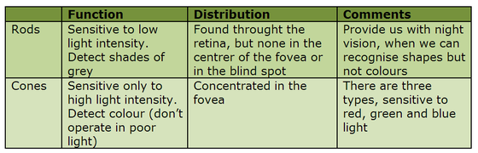
Trichromacy
Three types of sensors receptive to the wavelength of incoming irradiation have been established in humans, thus the term trichromacy.
Color sensitive receptors on the human retina are the cones.
The other light sensitive receptors on the retina are the rods which are dedicated to sensing monochromatically in low ambient light conditions.
S (short) with maximum sensitivity at ≈ 430 nm, M (medium) at ≈ 560 nm, and L (long) at ≈ 610 nm. Cones S, M, L are occasionally called cones B, G and R, respectively

Slide 63
Readings:
Digital Image Processing, Rafael C. Gonzalez & Richard E woods, Third Ed, Chapter 3
Hands-on Work:
https://github.com/mithunkumarsr/LearnComputerVisionWithMithun/blob/main/CV_3_Digital_Image_Processing_Exercises.ipynb;
Next Class:
Image Sharpening; Linear Filters; Edge Detection using Gradients, Sobel,Canny; Demonstration of Applications in Python
Line detection using Hough transforms; [ if possible]

Slide 64
Thank you

